Slide 1
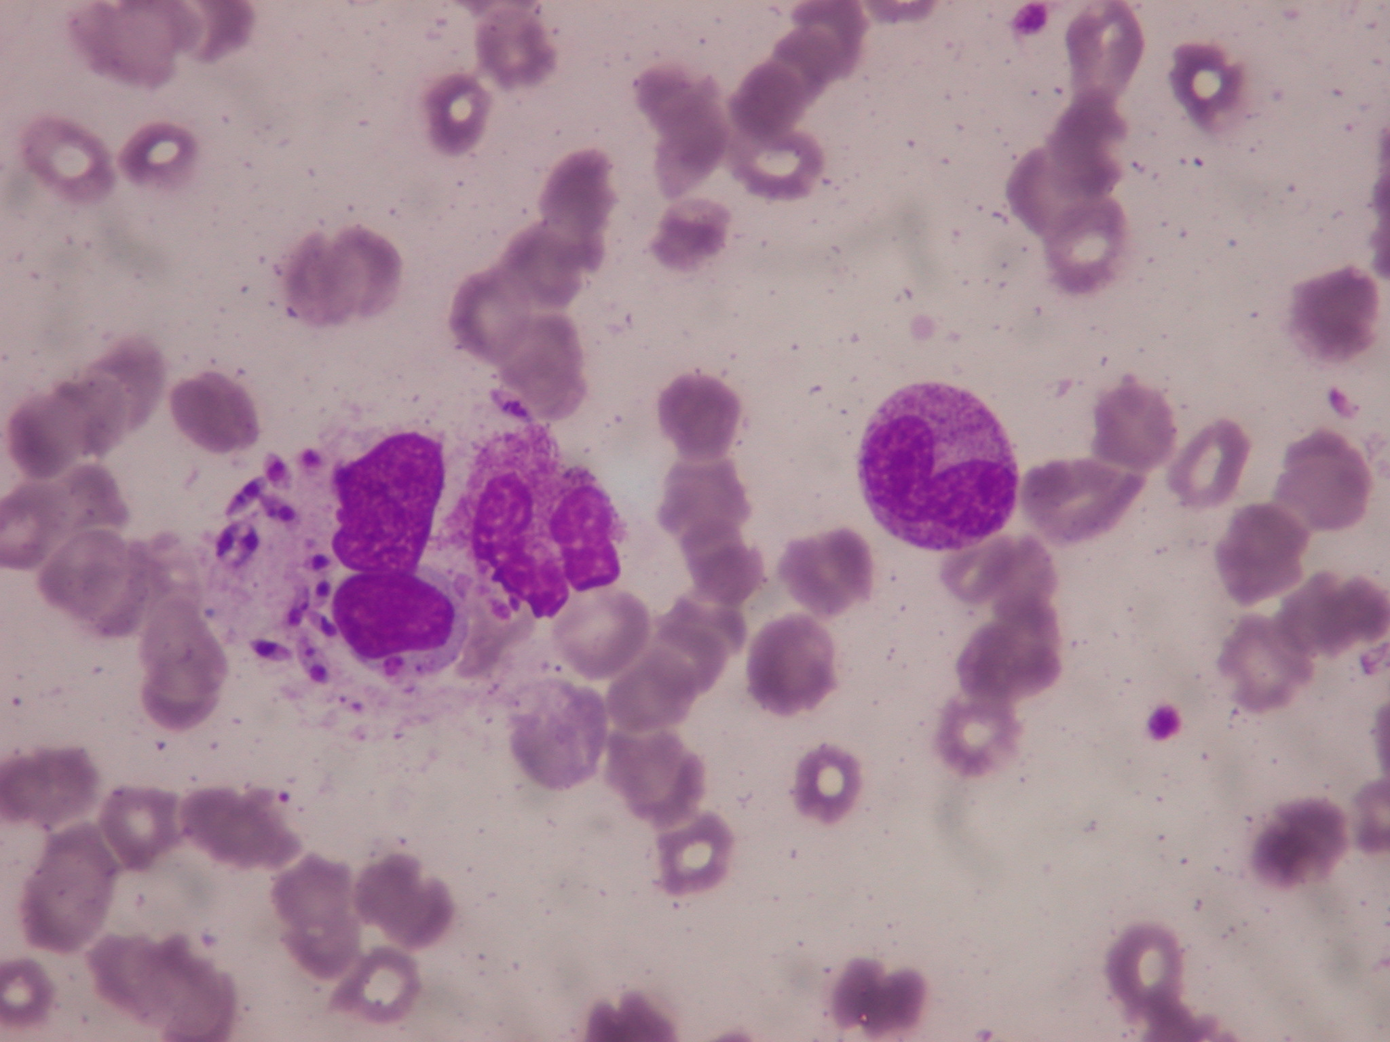
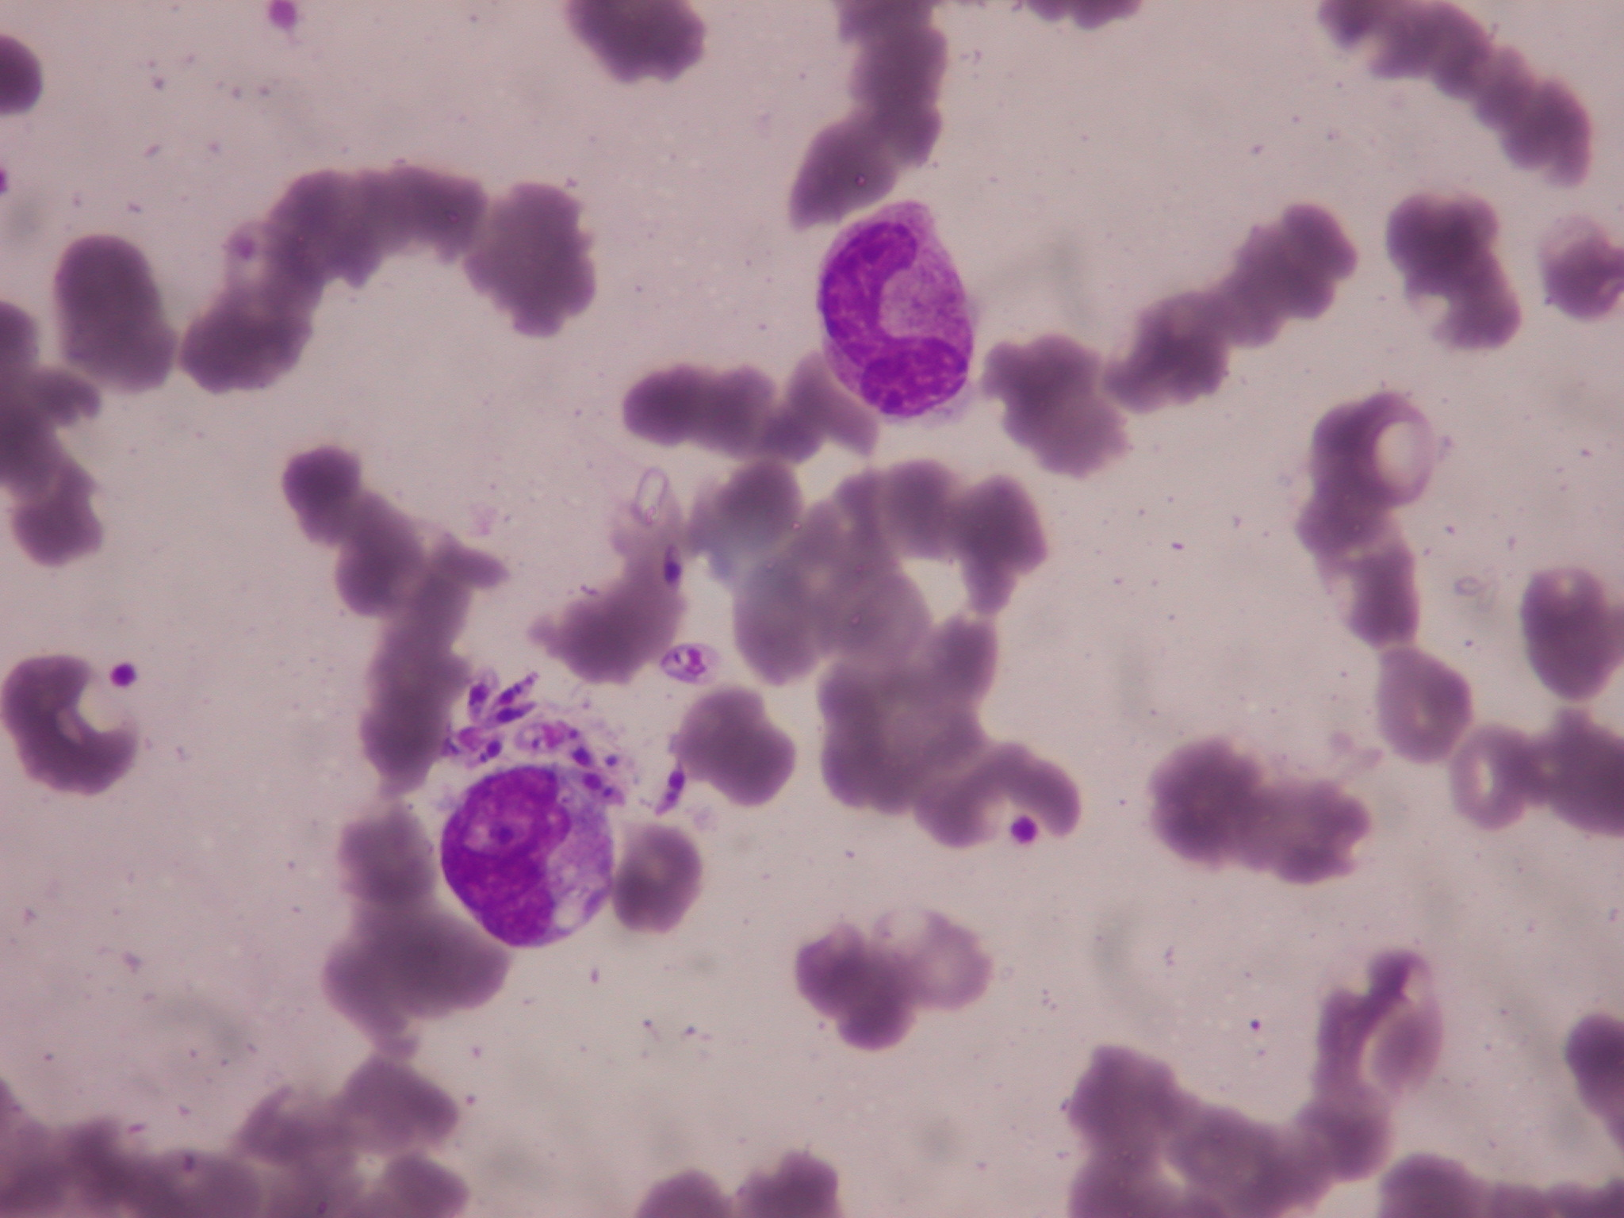
A
B
Notes:
Figure 1: Leishmania infantum in bone marrow smears. A: Macrophage containing amastigote forms (Leishman-Donovan bodies). B: Apparently extracellular parasites (May-Grünwald-Giemsa staining 400X)

Slide 2
Notes:
Figure 2: Histopathological observation of the brain tissue biopsy specimen showing Acanthamoeba trophozoite (A) and cysts (B, C, D) (hematoxylin-eosin staining); D: Nomarski differential interference contrast microscopy; n: nucleus; scale bars:A,C,D,10lm;B=20lm).

Slide 3
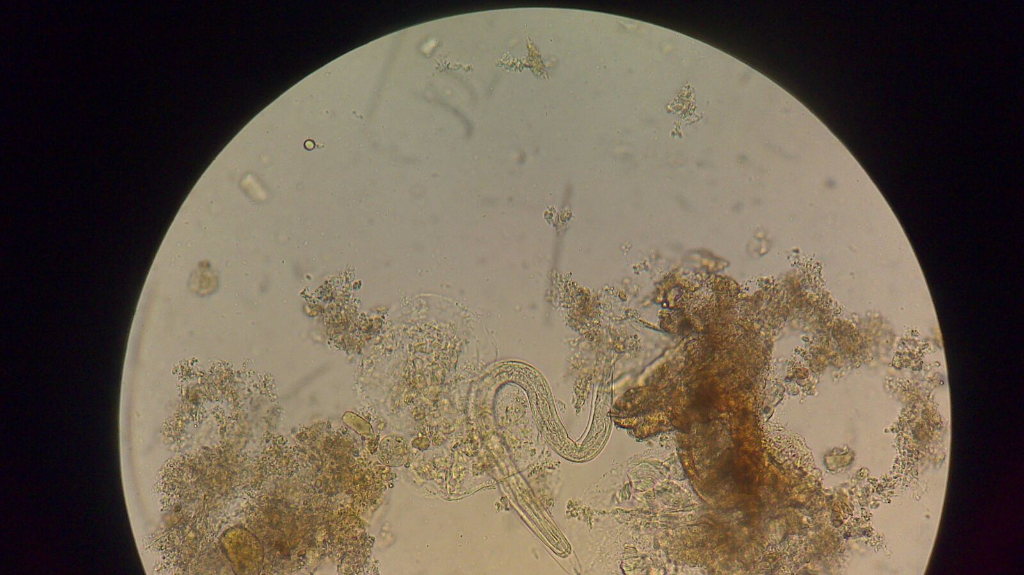
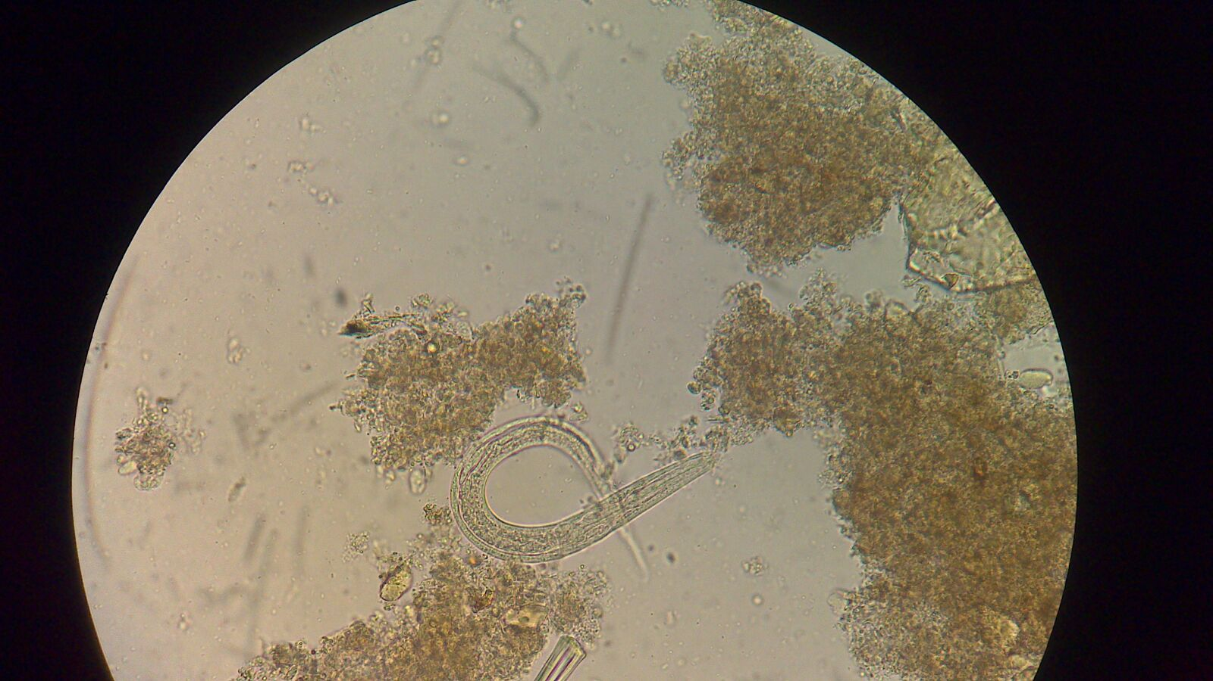
Notes:
Figure 3: Rhabditiform larvae of Strongyloides stercoralis in stool (Wet mount 400X)

