Slide 1
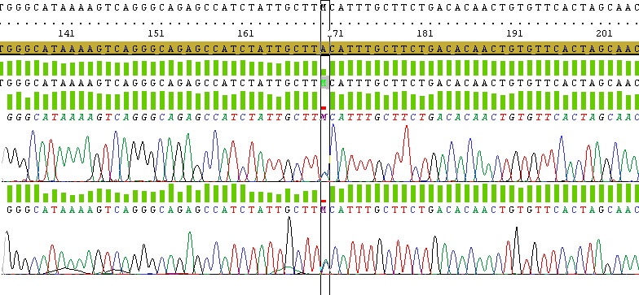
HBB Sequencing
CAP +1 (A->C) beta+
HGVS name HBB:c.-50A>C

Slide 2
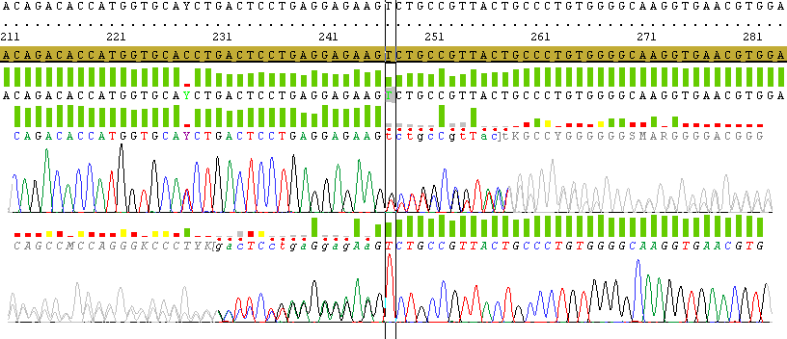
HBB Sequencing
Codons 8/9 (+G); AAG TCT(Lys;Ser)->AAG G TCT beta0
HGVS name HBB:c.27_28insG

Slide 3
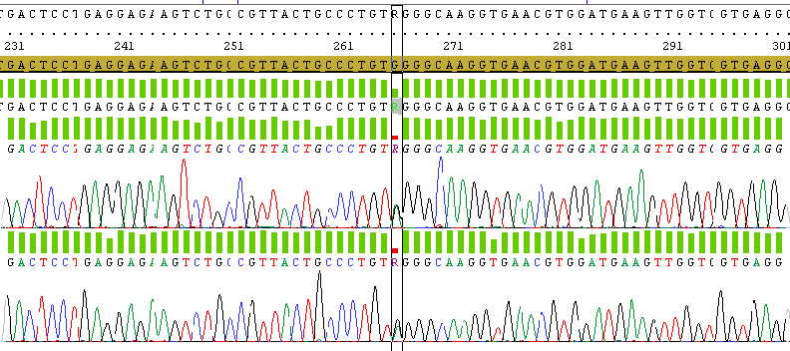
HBB Sequencing
Codon 15 (G->A); TGG(Trp)->TAG(stop codon) beta0
HGVS name HBB:c.47G>A

Slide 4
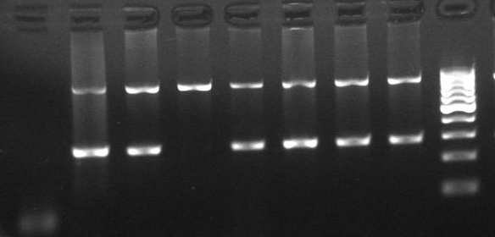
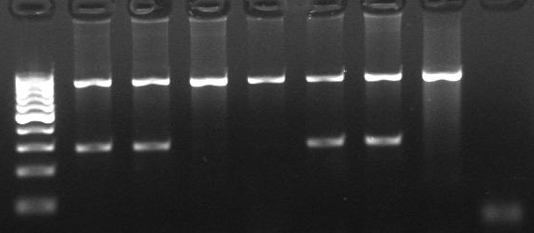
ARMS-PCR for IVS-I-5 (HBB: c.92+5 G>C) Normal allele (G)
8 7 6 5 4 3 2 1
ARMS-PCR for IVS-I-5 (HBB: c.92+5 G>C) Mutantallele (C)
1 2 3 4 5 6 7 8
1 : minor beta thalassemia
2: minor beta thalassemia
3: normal
4: normal
5: major beta thalassemia (control)
6: minor beta thalassemia (control)
7: normal control
8: negative control

